Slide 1
Occupational Specialist Component Content: Digital Production, Design and Development
The T Level T Level Technical Qualification in Digital: Digital Production, Design and Development includes a single Occupational Specialist Component. Therefore, there is a single synoptic assessment for the Occupational Specialist Component, which is an extended ‘design, development and implementation’ project. The synoptic element of the project is important in order to ensure that students are able to demonstrate threshold competence: this is the principal reason why the Occupational Specialism is assessed via a single extended project assessment to ensure that students are able to evidence all the skills required by the Performance Outcomes.
The T Level Technical Qualification in Digital: Digital Production, Design and Development Occupational Specialist Component consists of several activities grouped into four substantive tasks.
Each task will be completed during a window set by Pearson during which you will schedule supervised assessment sessions. In some cases, tasks will also involve opportunities for unsupervised activities where the requirements of the skills being assessed make this necessary.

Slide 2
Learning Objectives
Aims:
To understand how to design a product
Objectives:
To be able to identify how to design a product including:
Create interface designs.
Plan how to solve key problems (design algorithms).
Create data requirement designs.
Create a proof of concept.
Produce initial testing schedule.
Notes:
Create interface designs.
Plan how to solve key problems (design algorithms).
Create data requirement designs.
Create a proof of concept.
Produce initial testing schedule.

Slide 3
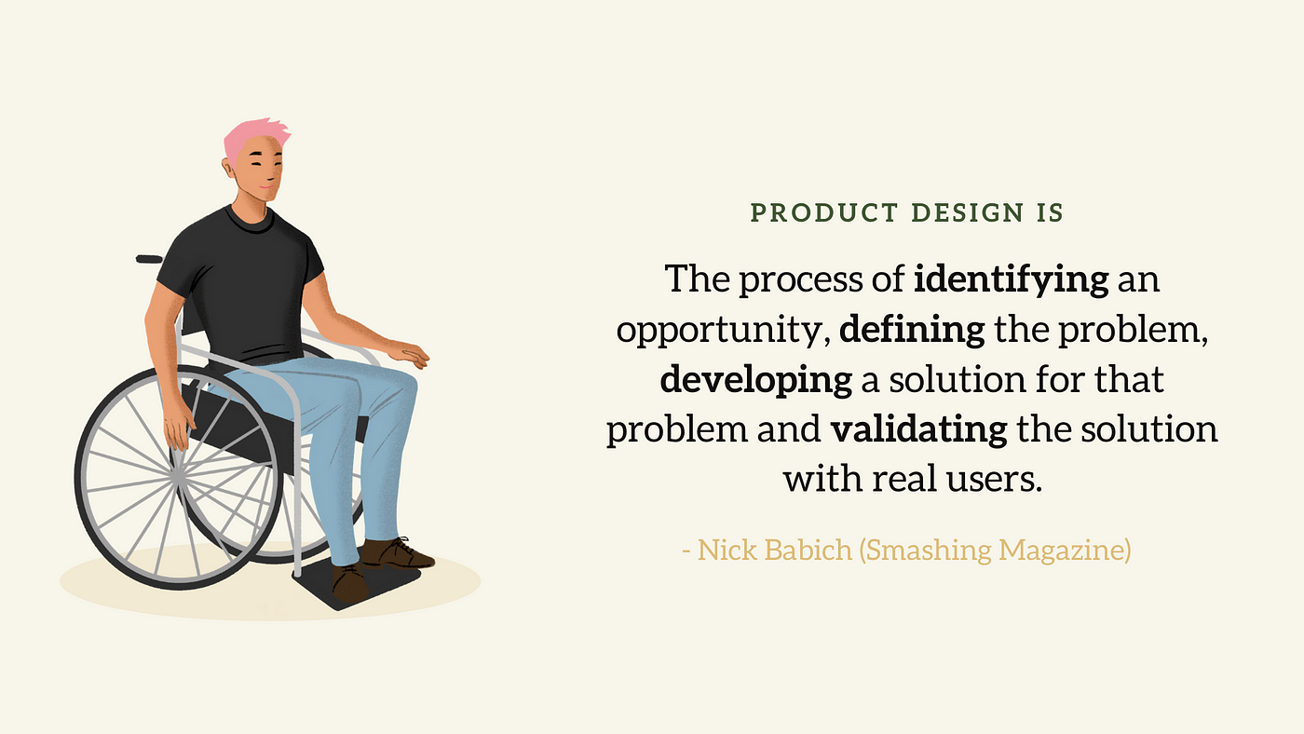
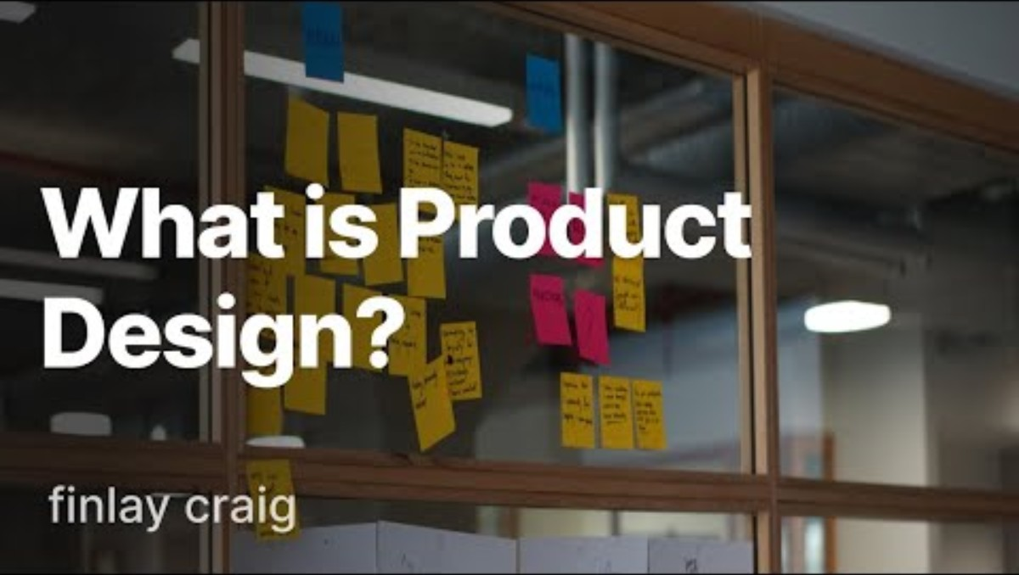
What Is Product Design?
Product design is the end-to-end process of creating a product that solves a user’s problem or meets a market need.
Intent: To ensure the product is usable, functional, and feasible within time and resource constraints.
Tools used:
Design Thinking
Product Requirement Documents (PRDs)
User Research Tools (e.g., interviews, surveys)

Slide 4
Key Stages in Product Design
A high-level view of the essential steps in the product design lifecycle.
Intent: To create a structured, logical pathway from concept to launch.
Stage | Description | Intent | Tools Used
1. Define the Problem | Understand user needs, business goals, and define clear objectives. | Align team focus and ensure product solves the right problem. | User interviews, surveys, personas, PRDs
2. Design the Interface (UI/UX) | Create wireframes, layouts, and user interactions. | Provide an intuitive, engaging user experience. | Figma, Sketch, Adobe XD, Balsamiq
3. Plan Core Functionality | Develop logic or algorithms to power product features. | Ensure functionality is accurate, efficient, and scalable. | Pseudocode, flowcharts, Visual Studio Code
4. Data Design | Define data structures and how information will be stored and retrieved. | Enable smooth and secure handling of data. | ER diagrams, MySQL Workbench, dbdiagram.io
5. Build Proof of Concept | Create a working prototype that demonstrates core features. | Test technical feasibility and validate the concept early. | React, Flask, Bubble, mock APIs
6. Initial Testing Plan | Schedule how and when features will be tested and validated. | Identify issues early and ensure product quality. | Jira, Selenium, Jest, TestRail

Slide 5
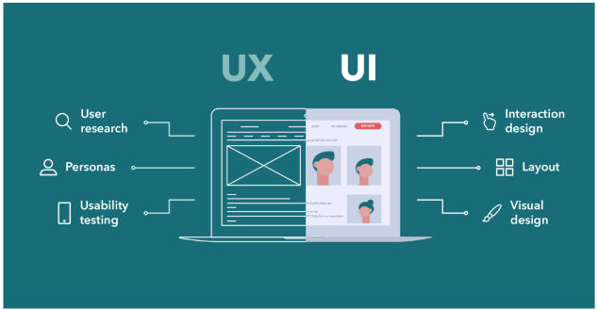
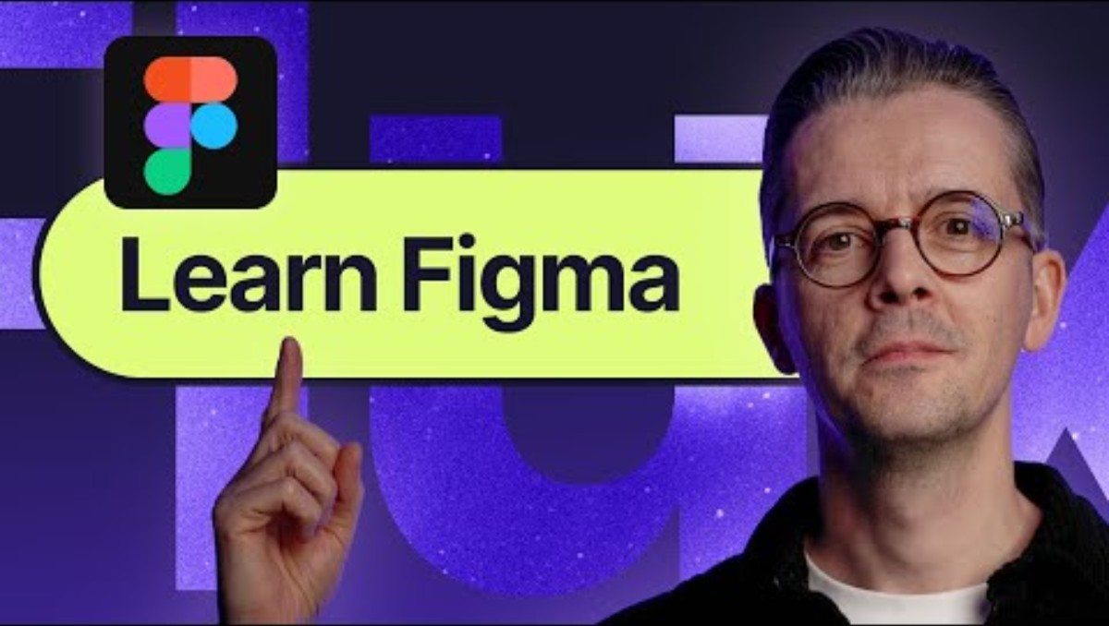
Create Interface Designs
Designing how users will interact with the product, including layout, navigation, and visual elements.
Intent: To ensure a smooth, intuitive, and engaging user experience.
Tools used:
Figma, Adobe XD, Sketch (UI/UX Design)
Wireframing tools (Balsamiq, Lucidchart)
Prototyping tools (InVision)
Notes:
https://www.youtube.com/watch?v=1SNZRCVNizg
https://www.youtube.com/watch?v=FTFaQWZBqQ8
https://www.youtube.com/watch?v=jQ1sfKIl50E
https://waverleysoftware.com/blog/how-to-build-software-product/
Figma is a cloud-based vector design tool that enables UX and UI designers to create, collaborate on, and share their designs. Designers using Figma can create high-fidelity prototypes and user interface designs for web, mobile, and desktop applications.
https://www.figma.com/web-design/

Slide 6
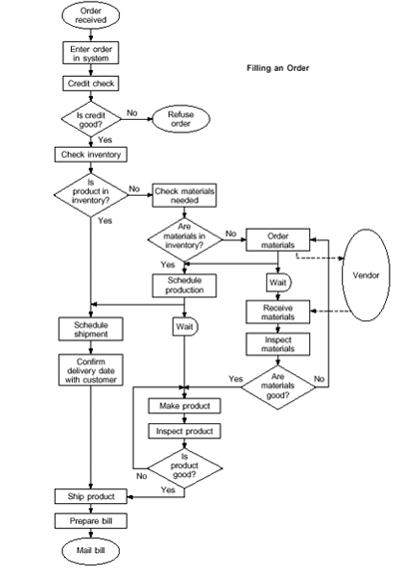
Plan How to Solve Key Problems (Algorithms)
Designing the logic and operations that power core product features.
Intent: To efficiently and accurately solve specific problems or enable essential functionalities.
Tools used:
Flowcharts and Pseudocode
Python, JavaScript, or C# (for logic prototypes)
Algorithm simulators or IDEs (Visual Studio Code, Replit)

Slide 7
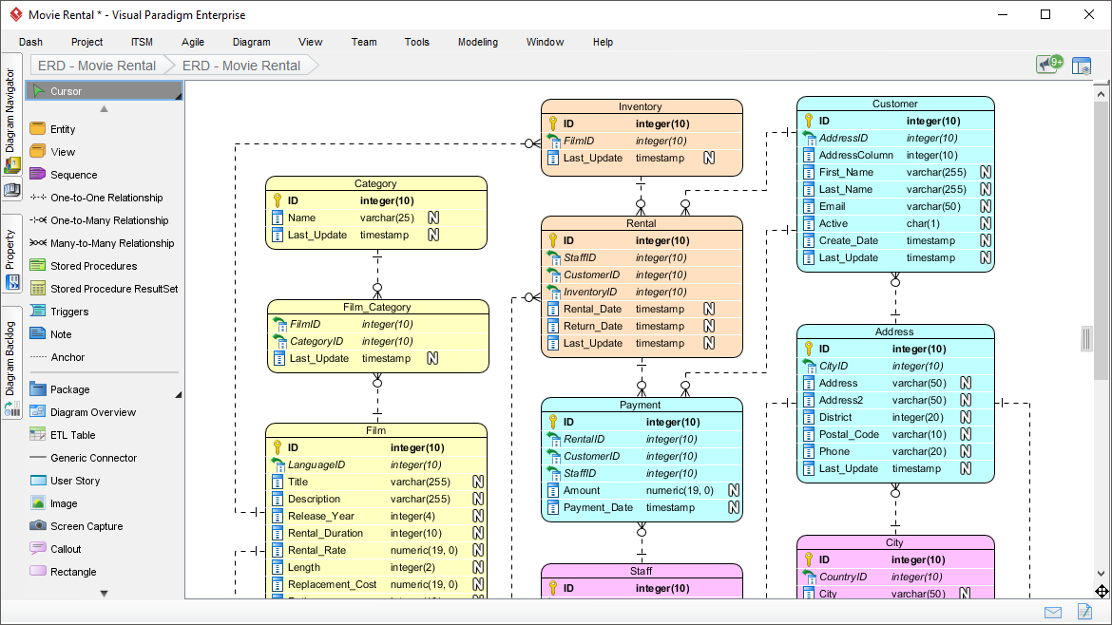
Create Data Requirement Designs
Define how data will be stored, retrieved, and related within the product.
Intent: To support functionality and scalability with a reliable data structure.
Tools used:
ER Diagram Tools (dbdiagram.io, Lucidchart)
SQL/NoSQL Databases (MySQL, MongoDB)
Data Modeling Tools (MySQL Workbench, pgModeler)
Notes:
https://www.archimetric.com/discovering-the-best-er-diagram-tool-for-data-architects/

Slide 8
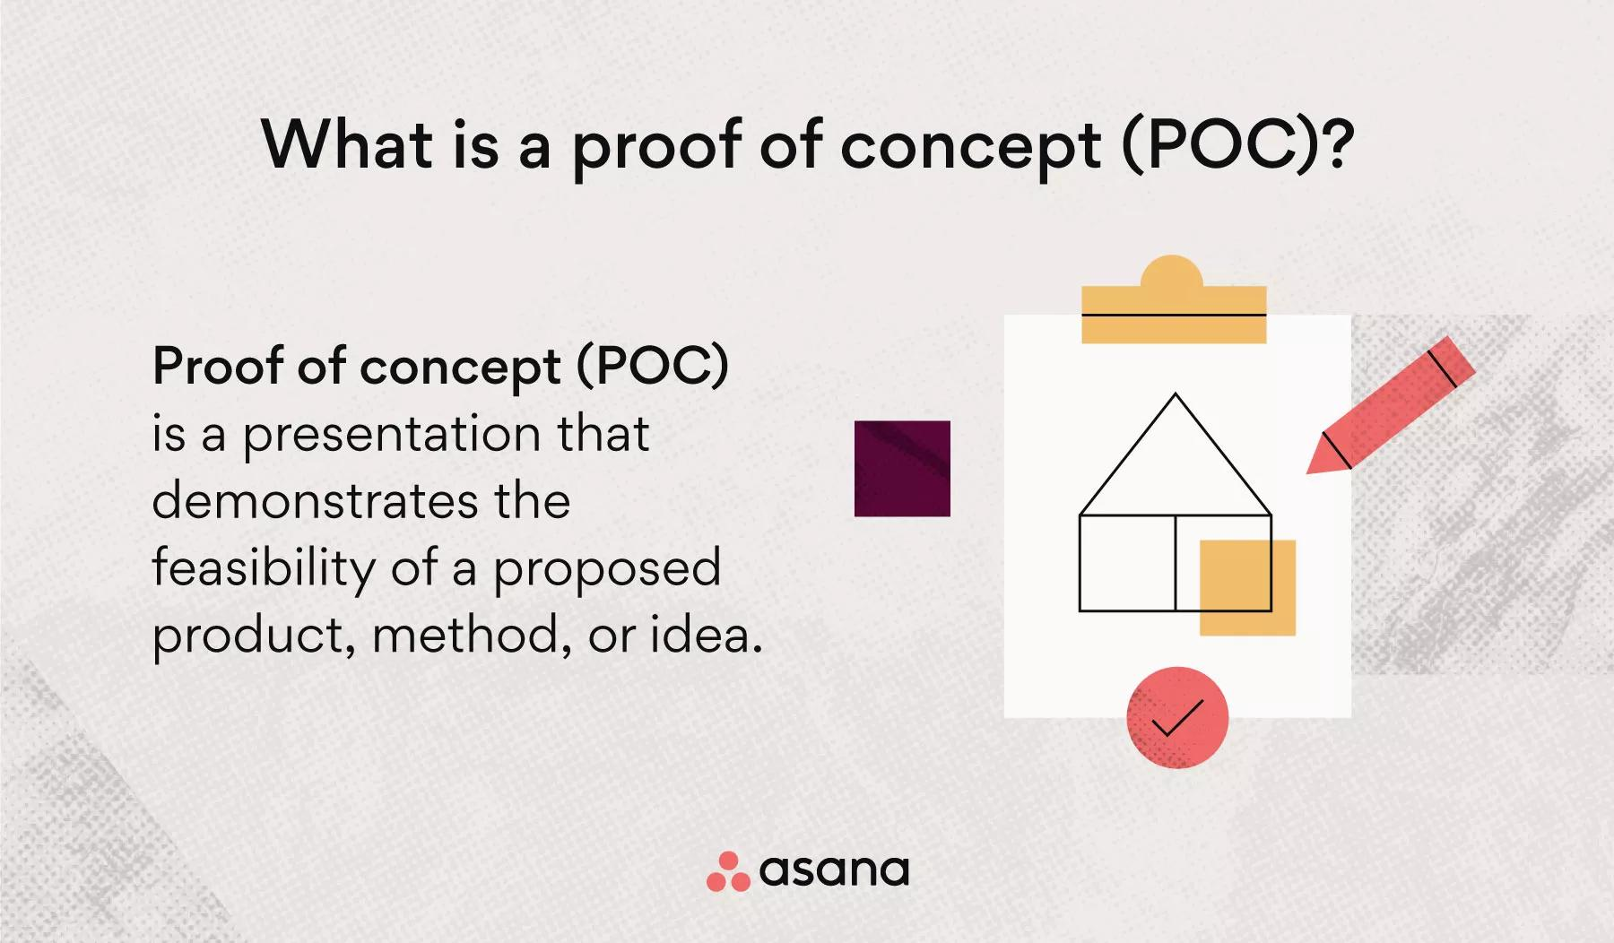
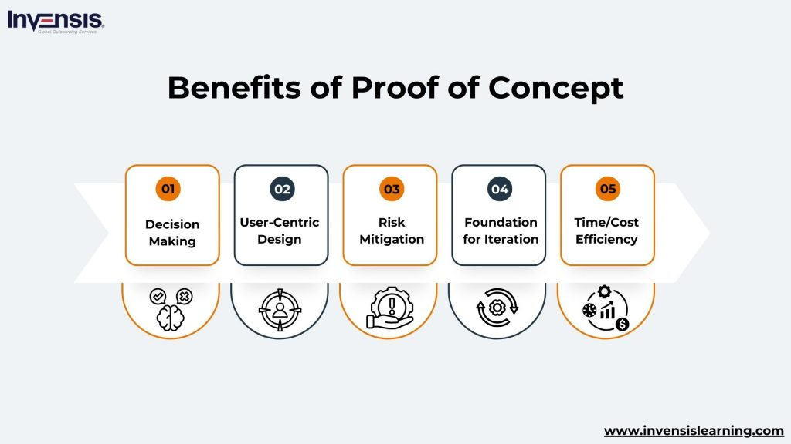
Create a Proof of Concept
Build a small, working version of the product to test feasibility and demonstrate value.
Intent: To validate technical assumptions and gather early feedback from stakeholders.
Tools used:
Low-code/no-code tools (Bubble, Glide)
Frameworks (React, Flask, Node.js)
Mock APIs or dummy data generators

Slide 9
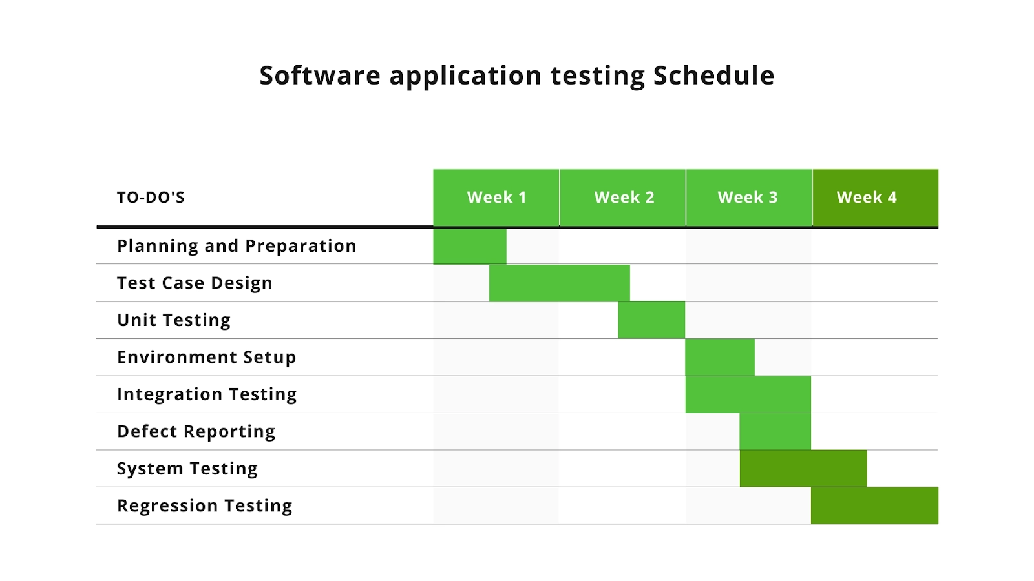
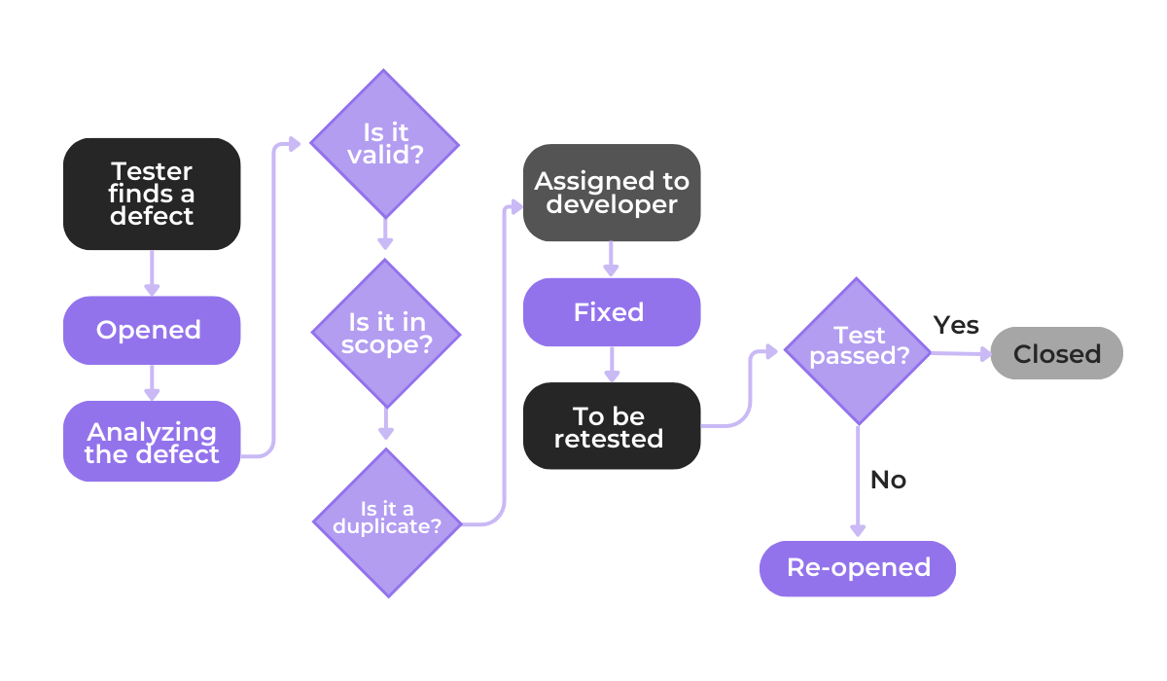
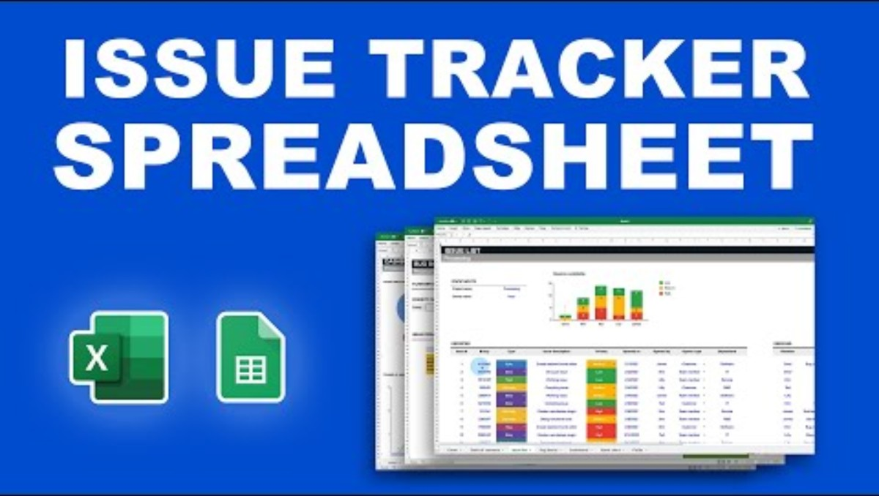
Produce Initial Testing Schedule
Plan how and when product components will be tested.
Intent: To identify bugs early, ensure quality, and reduce risk before deployment.
Tools used:
Test Case Management (TestRail, Zephyr)
Automated Testing Tools (Selenium, Jest)
Bug Tracking (Jira, GitHub Issues)
Notes:
https://www.projectmanager.com/templates/test-plan-template

Slide 10
Activity – Design Dash Build a Product from Scratch
Objective: Work as a team to design a brand-new digital product — just like real-world designers and developers do.
You’ll go through the key stages of product design, from idea to prototype.
Instructions:
Identify a real-world problem
Come up with a product idea
Design a simple user interface
Plan how the product will work (logic)
Decide what data it needs
Create a basic testing plan
Present your design to the class
Deliverables:
A clear product idea and target users
A sketch or wireframe of the main screen
A basic outline of how your product works (logic)
A list of data requirements
An initial testing plan
A short team presentation
Notes:
Time: 60–90 minutes (including presentations)
Purpose of the Activity
Apply the core stages of product design in a practical, team-based challenge
Strengthen your skills in problem-solving, planning, design thinking, and communication
Understand how designers and developers turn ideas into working products

